Slide 1
OPEN ENDED LAB PRESENTATION
Demonstrate an experiment for shift keying (ASK) and multiplexing (FDM) to communicate binary bits as analog signals; Demultiplex and convert them back into binary bits at the receiver.
Presented By - Group 4
Course Teacher - Abrar Fahim Liaf
Dept Of Electrical & Electronic Engineering

Slide 2
GROUP MEMBER
NAME | ID
MD. SHAHRIAR PARVEZ SHAMIM | 21-44998-2
ASHFAT AHMAD MEDUL | 21-44854-2
MD. ABU HOJIFA | 21-45081-2
MD. AL FAIAZ RAHMAN FAHIM | 21-45080-2
MD. OMAR FARUK SAKIB | 21-45077-2

Slide 3
OBJECTIVE
To explore ASK modulation for converting digital data into analog signals.
To explain FDM's role in multiplexing multiple analog signals.
To demonstrate the de-multiplexing process for retrieving individual analog signals.

Slide 4
INTRODUCTION
What Is Multiplexing?
Combining Signals
Optimizing Resource Usage
Three Types of Multiplexing:
FDM (Frequency Division Multiplexing)
TDM (Time Division Multiplexing)
WDM (Wavelength Division Multiplexing)

Slide 5
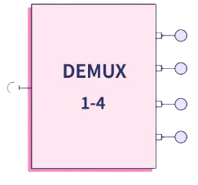
INTRODUCTION
What Is DE-Multiplexing?
Signal Separation
Data Retrieval
Three Types of Multiplexing:
FDDM (Frequency Division Demultiplexing)
TDM (Time Division Demultiplexing)
WDDM (Wavelength Division Demultiplexing)

Slide 6
INTRODUCTION
What Is FDM?
FDM (Frequency Division Multiplexing) : is a data communication technique that enables simultaneous transmission of multiple signals by dividing the available frequency bandwidth into non-overlapping bands.
Key points
Multiplexing: FDM allows multiple signals to be combined onto a single transmission medium.
Simultaneous Transmission: FDM enables simultaneous transmission of multiple signals over the same communication medium.
Applications: FDM is commonly used in various communication systems, including traditional analog telephone lines, radio broadcasting, and cable television.
Challenges: It may face challenges such as crosstalk between channels if not properly managed.

Slide 7
PROCEDURES
Two 8-bit binary digital data was taken.
These two 8-bit binary data was passed through ASK modulation separately using the ASK modulation process.
The result analog signal of the input digital signal was plotted in a graph.
The analog signals were then passed to the FDM modulation process by converting them into one composite signal.
The composite signal was plotted on the graph.
The composite signal was de-modulated using FDM process to recover the old analog signal using low-pass filter and other processes.
The recovered analog signal was plotted on the graph using figure plotting techniques.
Finally, binary data was retrieved from the analog signal and shown in command line.

Slide 8
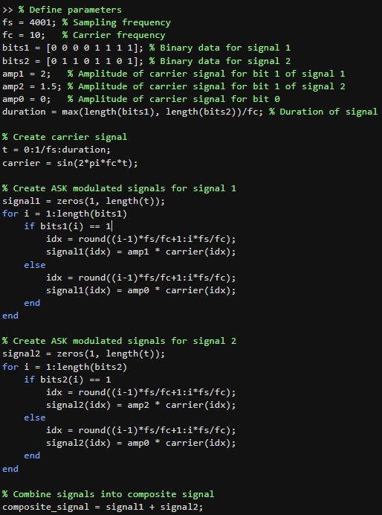
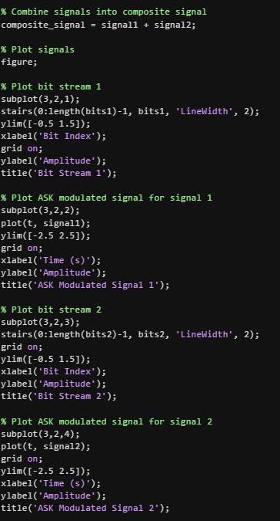
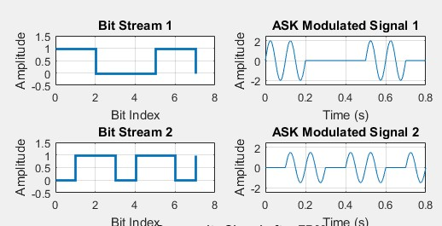
RESULTS
Binary to Analog Signal Conversion using ASK

Slide 9
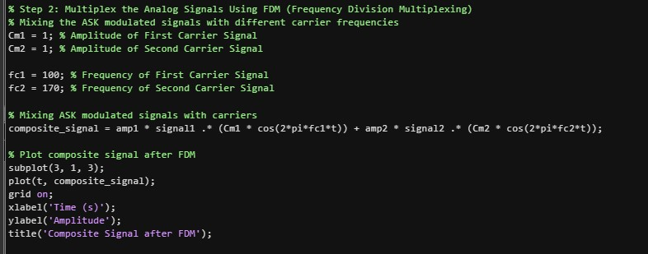
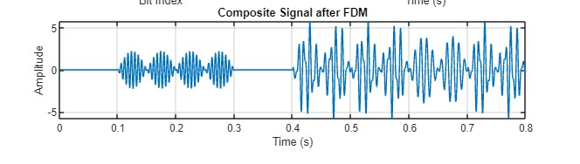
RESULTS
Composite Signal Generation using FDM Multiplexing

Slide 10
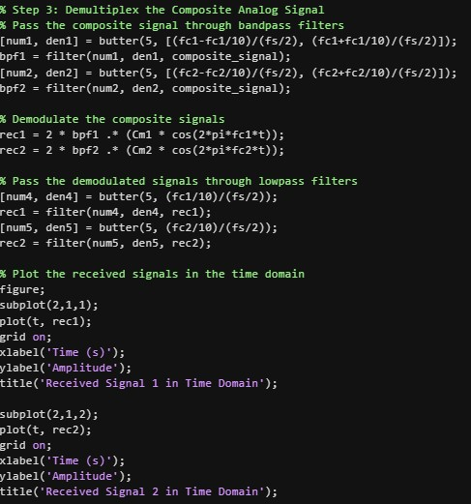
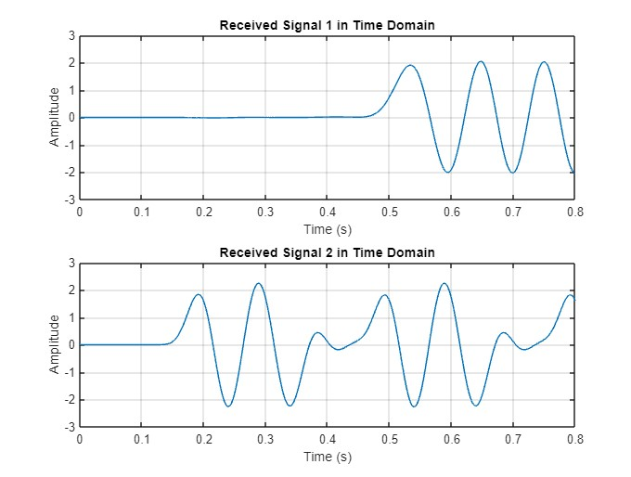
RESULTS
Analog Signal Regeneration Using FDM De-Multiplexing

Slide 11

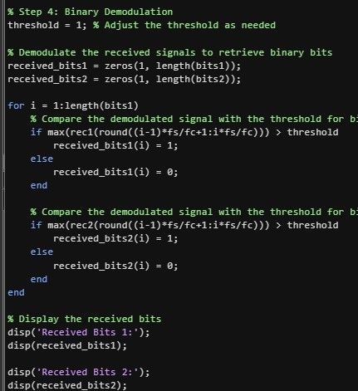
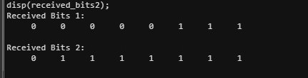
Convert the individual Analog signals back into the original Digital data (as binary bits)

Slide 12

IMPACT ON SOCIETY
Smarter Communication: Project optimizes data transfer, benefiting communication speed and reliability.
Resource Efficiency: Improved data handling supports seamless activities like streaming and online interactions.
Economic Growth: Efficient data transfer contributes to economic development by fostering innovation, supporting e-commerce, and enhancing overall productivity.
Global Connectivity: The project facilitates seamless global communication, reducing geographical barriers and fostering a more connected world.
Education Accessibility: The optimized data transfer can benefit remote learning by facilitating high-quality video lectures, interactive content, and real-time collaboration, thereby improving access to education.

Slide 13
IMPACT ON HEALTH
Enhanced Medical Data: Project aids faster, reliable transfer of vital medical information, improving patient care and diagnostics.
Remote Healthcare: Optimized data transmission supports telemedicine, extending medical services to remote areas, and enabling timely interventions.
Emergency Response: Faster and more reliable data transfer enables quicker response times in emergency situations, potentially saving lives through rapid communication and decision-making.
Disease Surveillance: The enhanced data handling capabilities support improved disease surveillance, aiding in the early detection and containment of outbreaks for better public health management.
Personalized Medicine: Improved data transmission supports the exchange of detailed patient information, fostering the development of personalized medicine and tailored treatment plans.

Slide 14


IMPACT ON CULTURE
Global Connectivity and Cultural Exchange: ASK and FDM facilitate the exchange of information globally, fostering cultural understanding and collaboration.
Entertainment and Media Consumption: ASK and FDM influence how we consume entertainment, powering the seamless delivery of audio and video content.
Economic Implications and Innovation: The widespread use of ASK and FDM has economic implications, fostering innovation and contributing to overall technological advancement.

Slide 15


Discussion
Practical Application in Signal Processing.
Bandwidth Optimization through FDM.
Demultiplexing and Demodulation.

Slide 16
Conclusion
The experiment offers a practical understanding of modulation and multiplexing techniques used in communication systems.

Slide 17

THANK YOU!

